Slide 1



Data science E-retail factors for customer activation and retention: A case study from Indian e-commerce customers
Submitted by:
KUMAR GOURABH
(kumargourabh94@gmail.com)

Slide 2
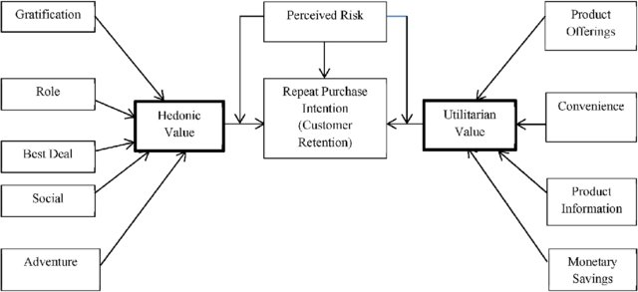
Business Problem Framing & Conceptual Background of the Domain Problem
Problem Statement: Analyse the Features affecting Customer Satisfaction & retention and test if brand preference depends on factors like age and gender.
The combination of both utilitarian value and hedonistic values are needed to affect the repeat purchase intention (loyalty) positively.
The data is collected from the Indian online shoppers. Results indicate the e-retail success factors, which are very much critical for customer satisfaction.

Slide 3
Analytical Problem Framing
Data Scientists must apply their analytical skills to give findings and conclusions in detailed data analysis written in jupyter notebook.
I will be going about this task in 2 parts:
• Descriptive Statistics
• Inferential Statistics

Slide 4
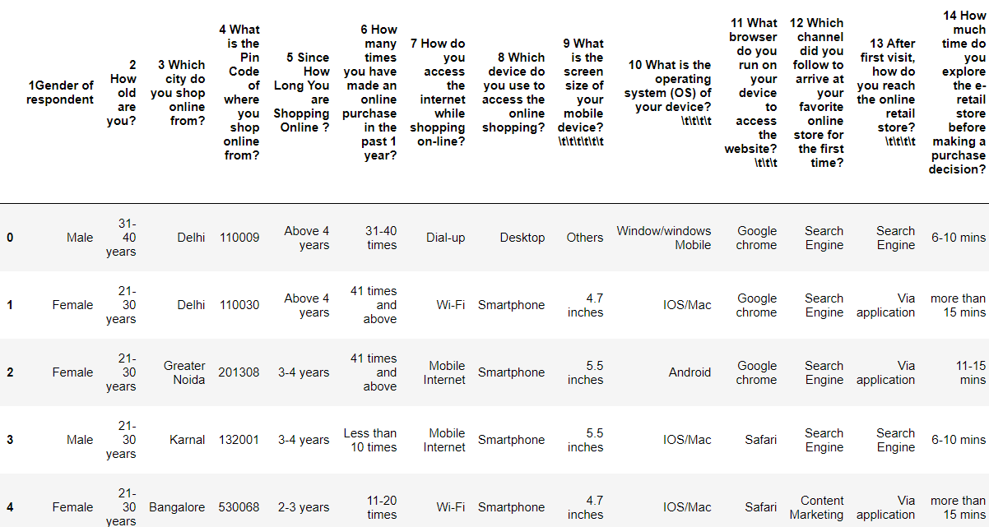
Data Set
There are two sheets (one is detailed) and second is encoded in the excel file. The data is in the form of a Questionnaire - probably Google Forms.
Shape – 269 Rows; 71 Columns

Slide 5
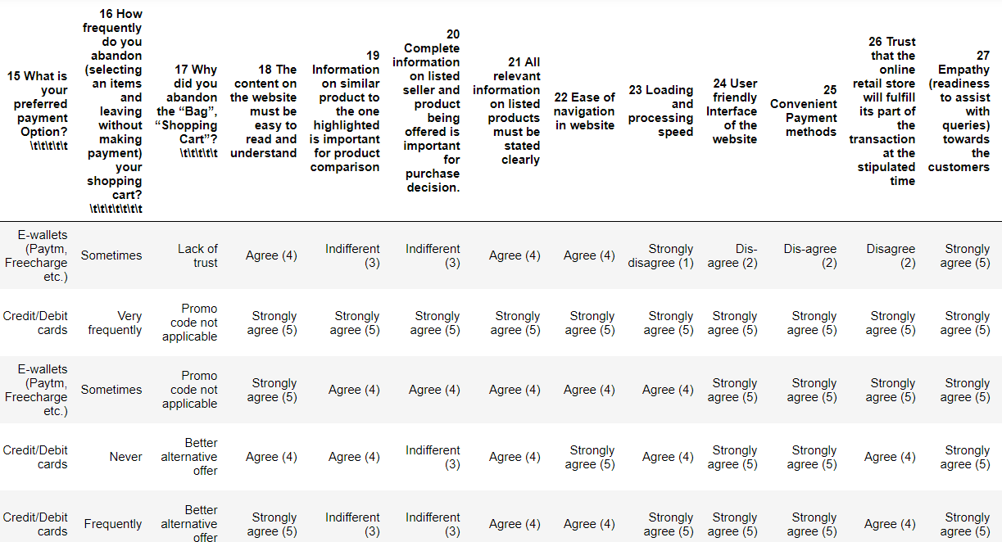

Slide 6
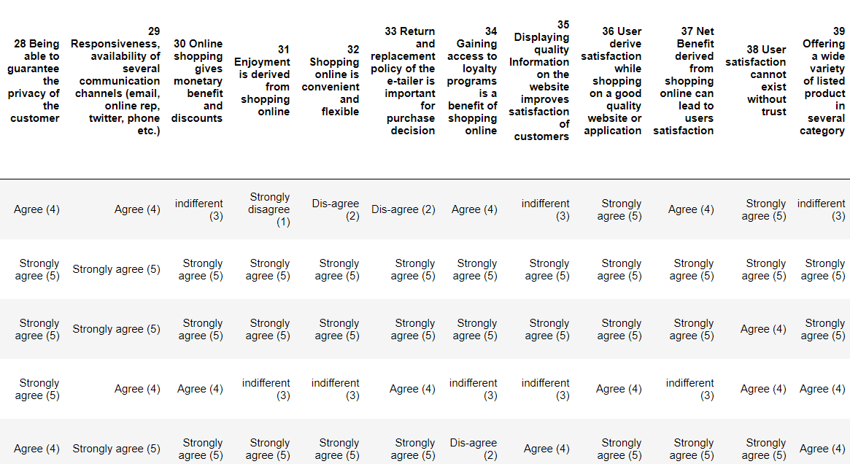

Slide 7
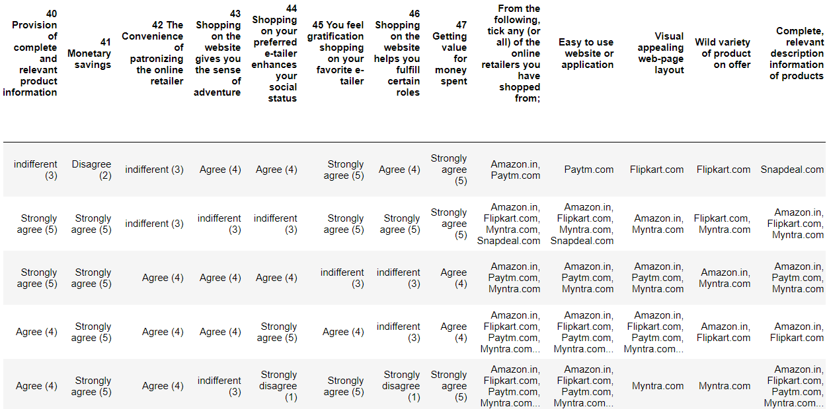

Slide 8
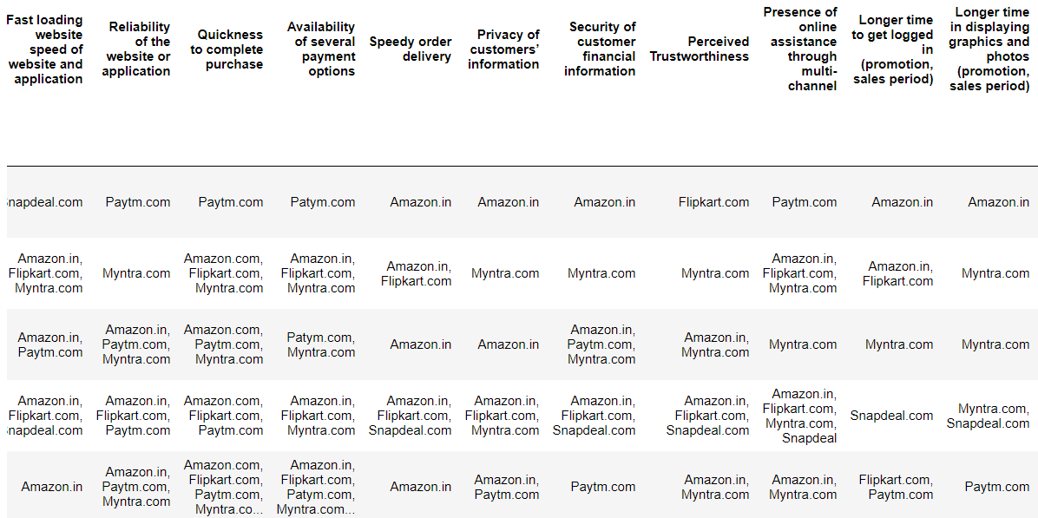
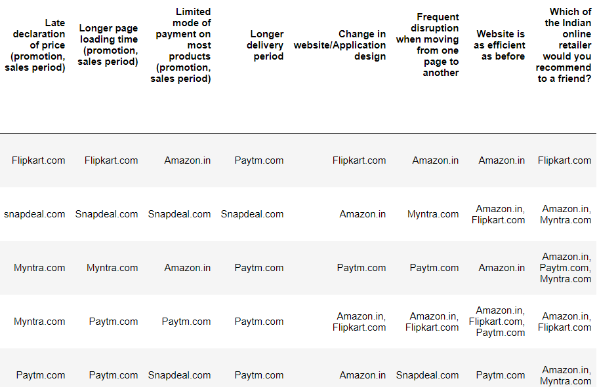

Slide 9
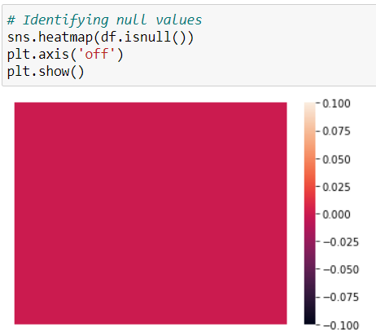
Checking for Null Values in the dataset
The heatmap shows there are no null values in the collected dataset.

Slide 10
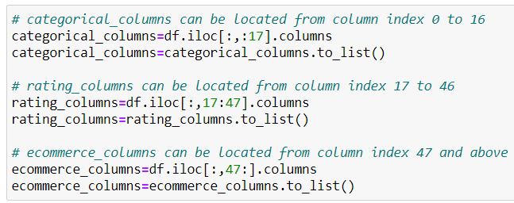
1. Descriptive Stats
As there are a huge number of features, it makes sense to divide the data into these categories:
categorical_columns = This will contain demographic features and other person specific features like age, gender, browser]
rating_columns = This will contain all questions which have answers in the form of (Agree, Strongly Agree, Indifferent etc.)
ecommerce_columns = This will contain all questions which have answers in the form of (amazon, flipkart, myntra etc.)

Slide 11
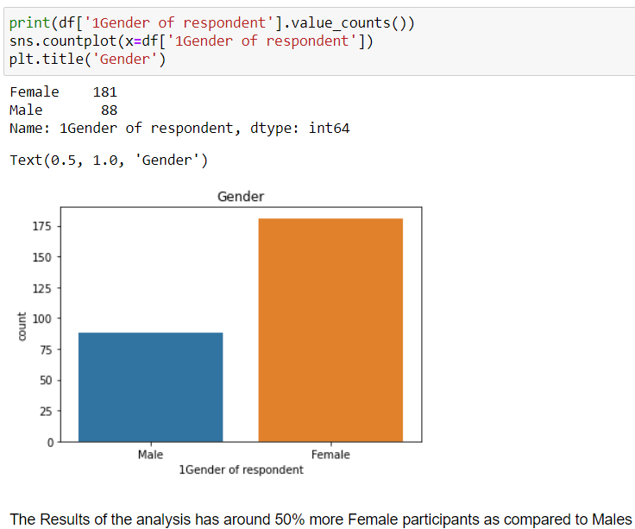
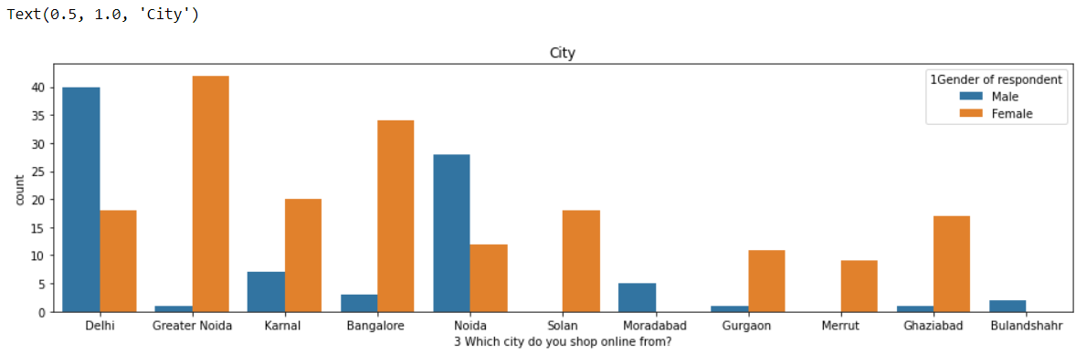
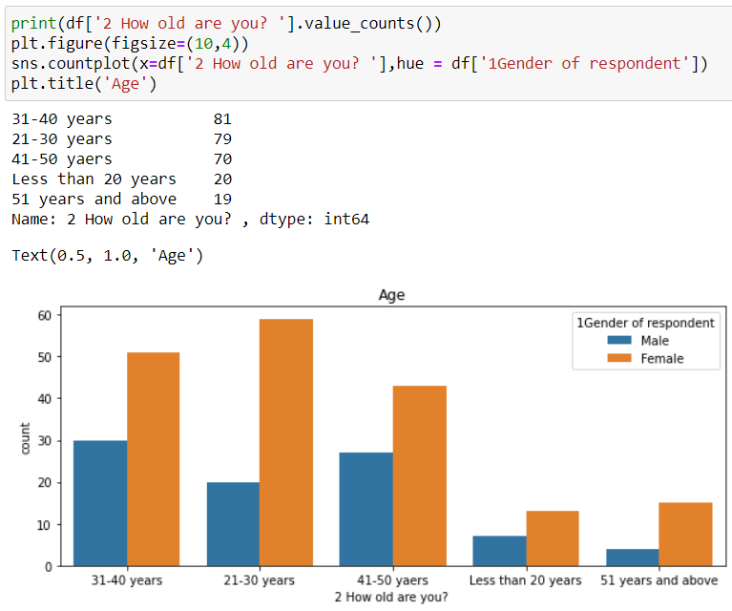
Let's have a look at the overall demographics of the collected sample

Slide 12
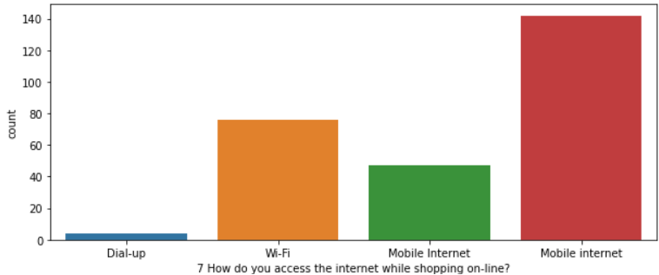
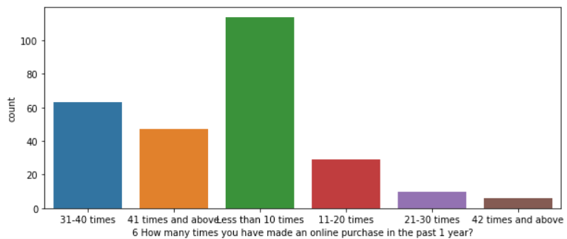
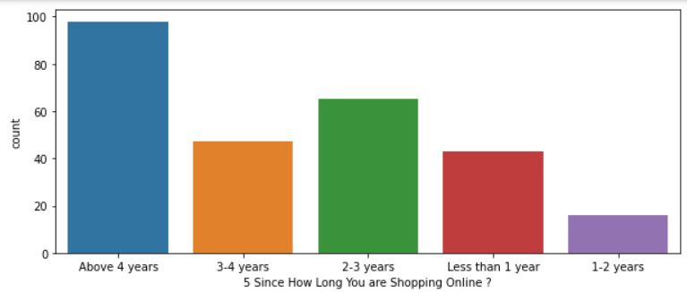
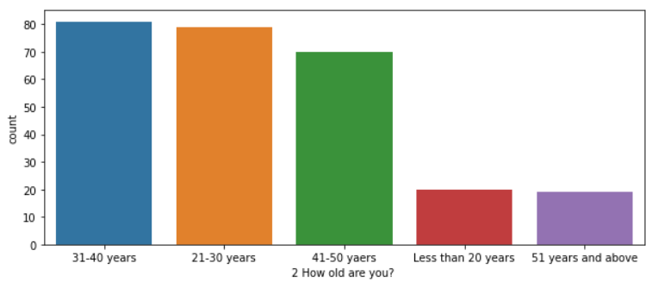
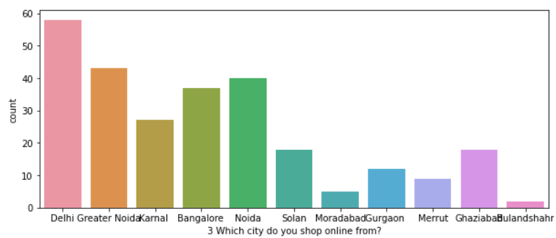
Univariate Analysis

Slide 13
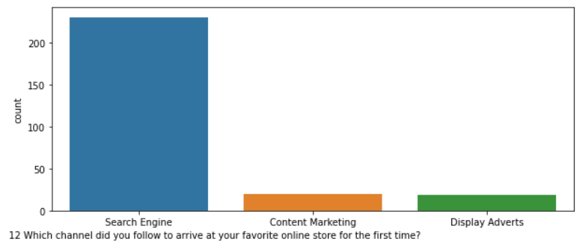
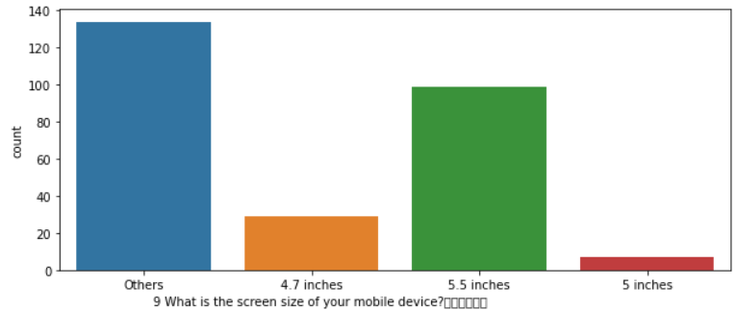
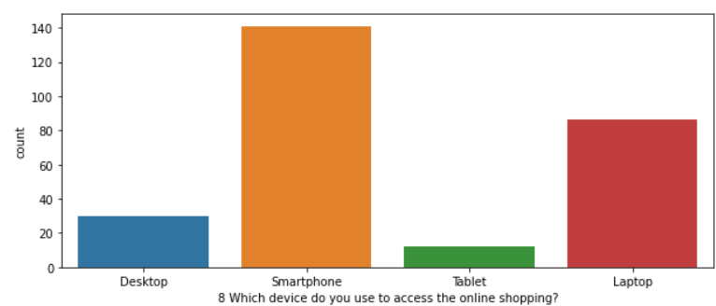
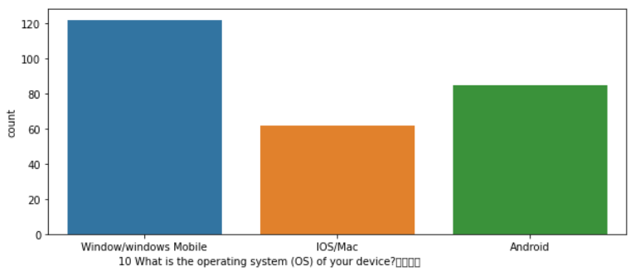
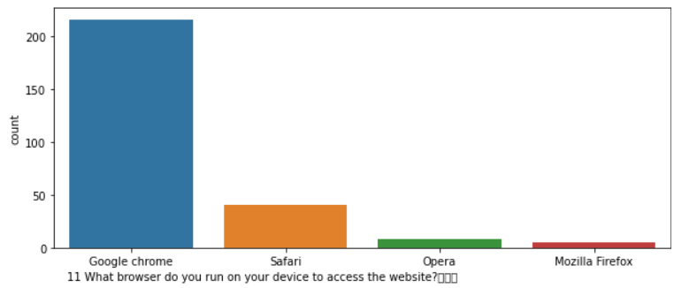

Slide 14
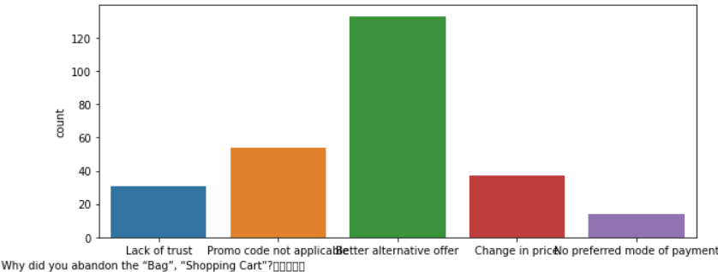
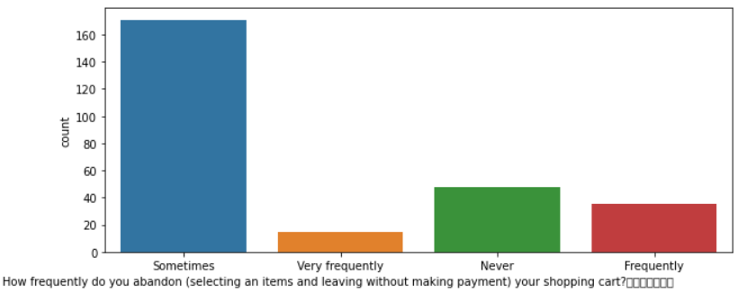
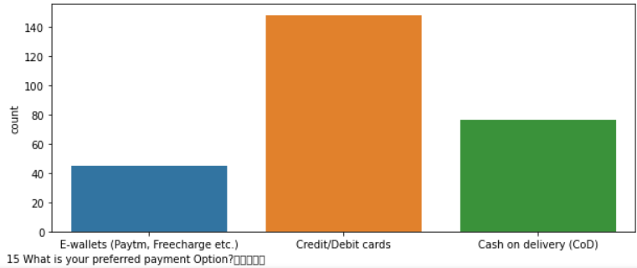
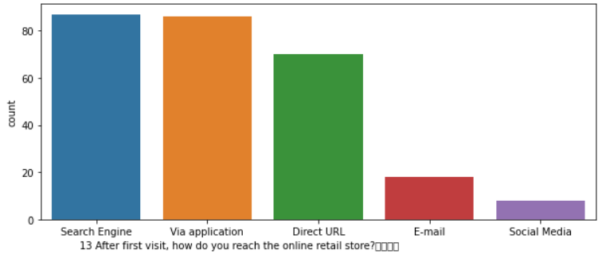
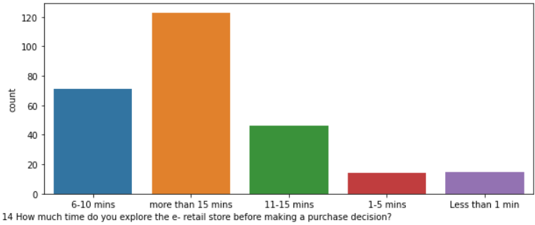

Slide 15
Some Important Conclusions Based on the initial Questions
Age: 85% of the people are within age group 20-50 years. Very small percentage of people are less than 20 or more than 50 years old.
Delhi, Greater Noida, Noida and Bangalore have the maximum participants.
Maximum number of participants have been using Online Shopping platforms for more than 4 years.
Purchases in last 1 year: Maximum People have made purchases less than 10 times. Next in line are 30-40 and 40+
Most people use Mobile internet during shopping on-line.
Very few people use desktops or tablets; while most are using Smartphones and laptops.
A large percentage of people use Google Chrome.
Search Engines are the most used channel which guide people to their favourite online store.
Most people take purchase decision after spending more than 15 minutes.
Credit/Debit cards are the most used mode of payment.
Maximum people abandon the items in cart 'sometimes' as opposed to never or frequently.
The biggest reason to abandon is 'Better alternative offer.

Slide 16

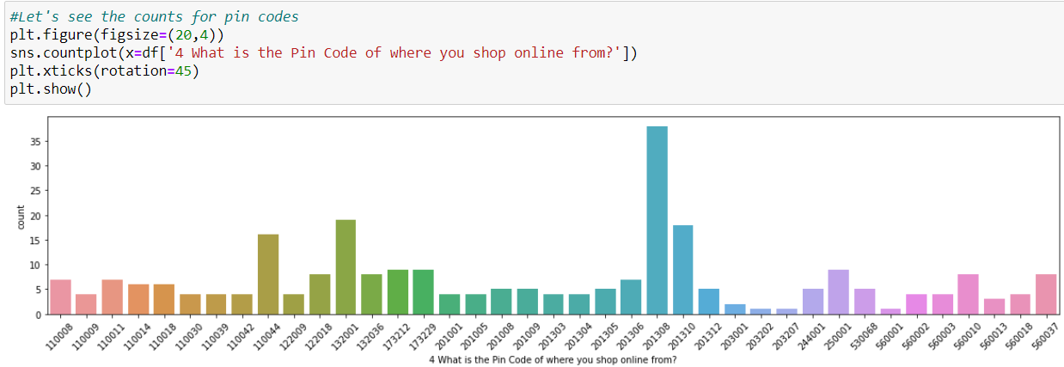

Location(Pin-Code)
Pin Code 201308: Has the Most Number of buyers, closely Followed by 132001, 201310 and 110044.
201308 and 201310: These belong to Gr. Noida, Gautham Budha Nagar. As this area consists of the Knowledge Park, where a lot of Students are available, this may have led to the high count.
132001 - Karnal, Haryana
110044 - South Delhi, Badarpur Area

Slide 17
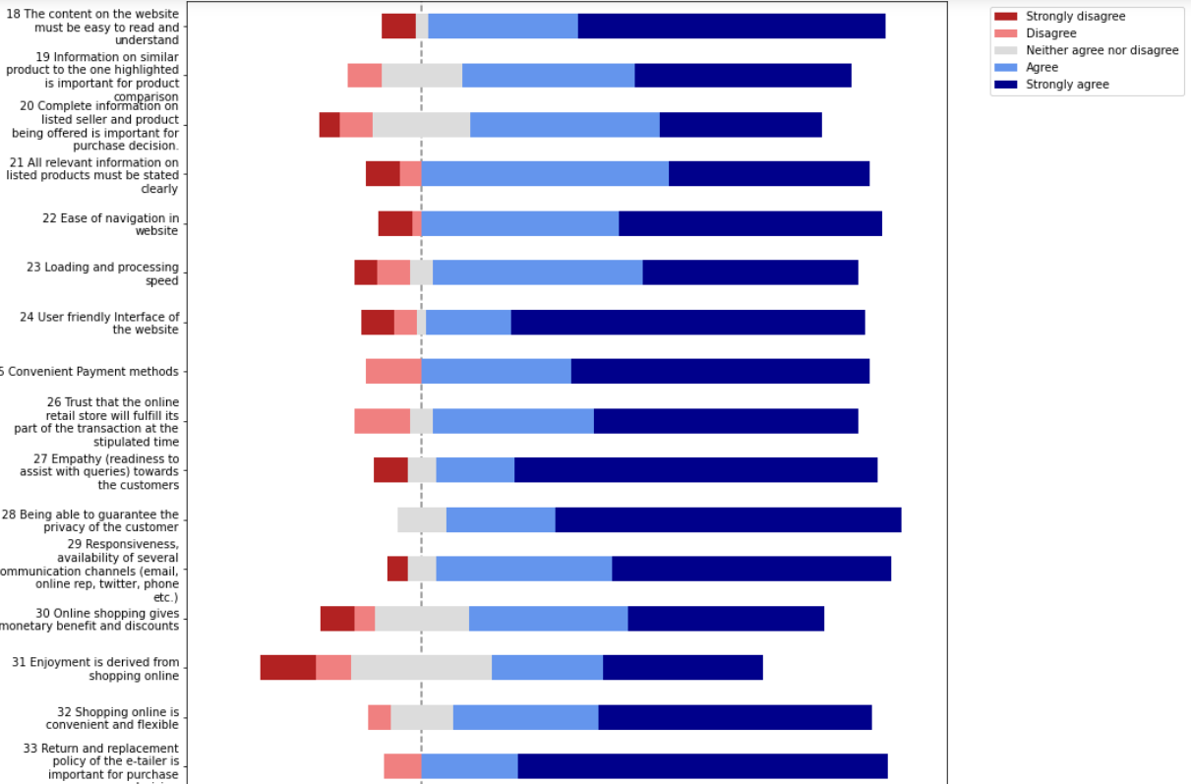
Rating based parameters

Slide 18
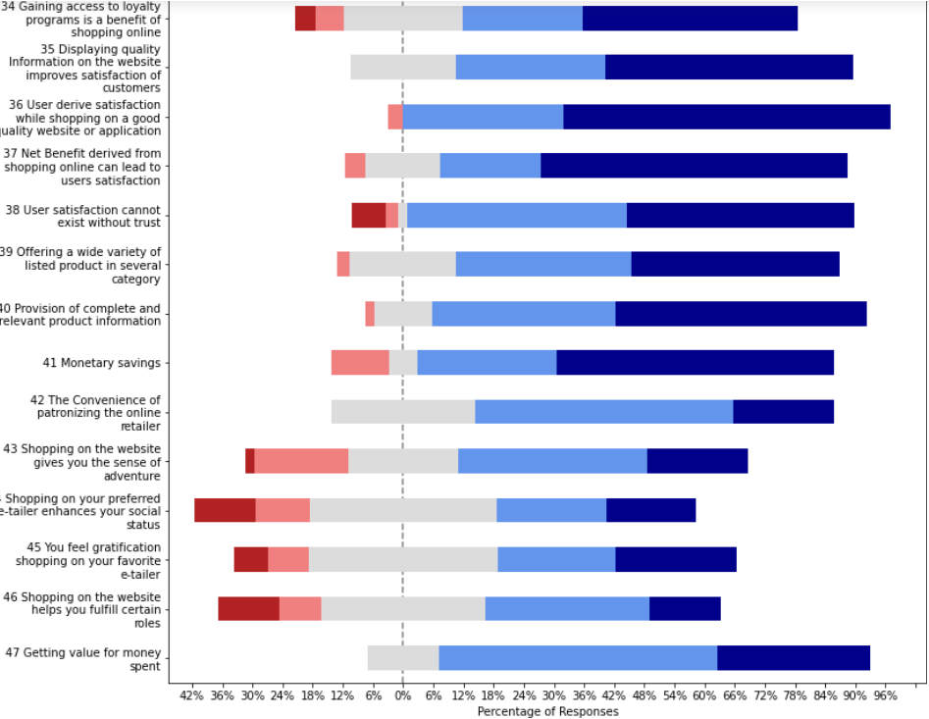
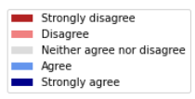

Slide 19
Key Observations
A large majority of people believe that content on the website must be easy to read and understand.
People agree that Information on similar product to the one highlighted is important.
70% people believe that Complete information on listed seller and product is important for purchase decision.
90% people believe that All relevant information on listed products must be stated clearly
For more than 90% people, ease of navigation of website, loading or processing speed as well as User friendly Interface of the website is important.
Other important parameters are - Convenient Payment Methods, privacy of customers, responsiveness, availability of several Communication channels, return and replacement policy.

Slide 20
Important Factors for Satisfaction
Around 20% people don't that Displaying quality Information on the website improves satisfaction of customers. The other 80% agree that it is important.
Almost all participants believe that User derive satisfaction while shopping on a good quality website or application.
Very high percentage of people believe that Net Benefit derived from shopping online can lead to user-satisfaction.
Most People believe that User satisfaction cannot exist without trust.

Slide 21
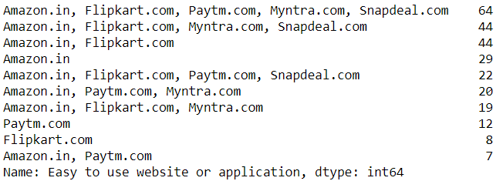
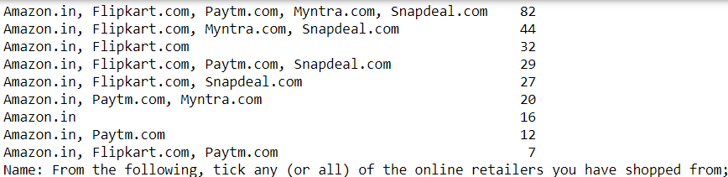
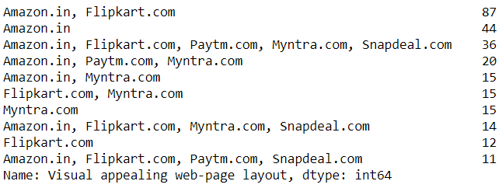
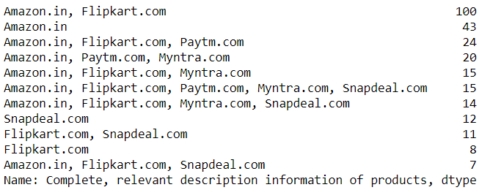
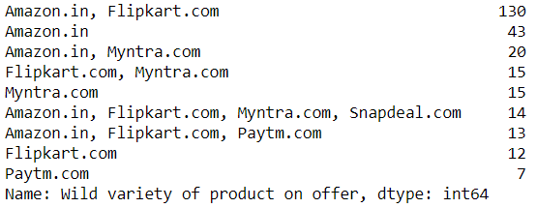
Company Specific Questions

Slide 22
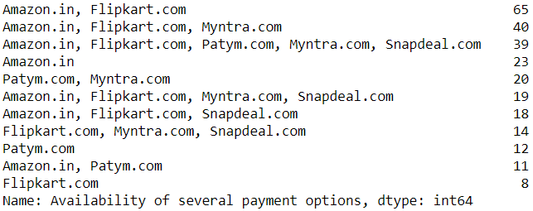
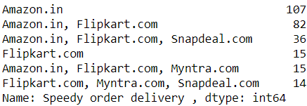
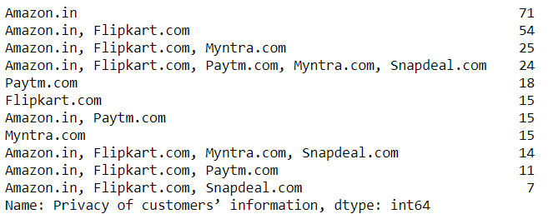
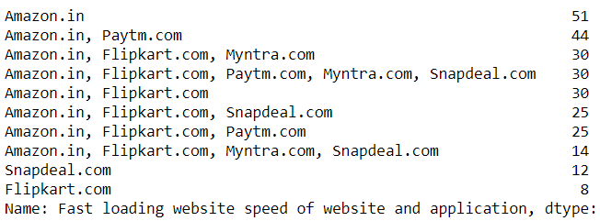
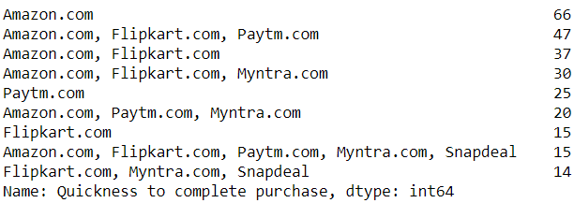
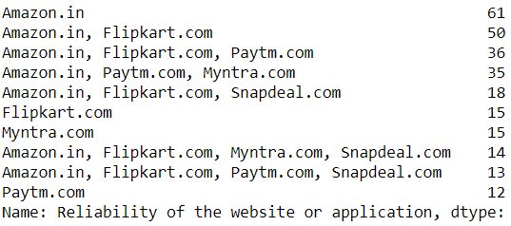

Slide 23
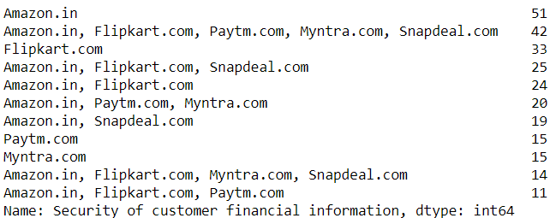
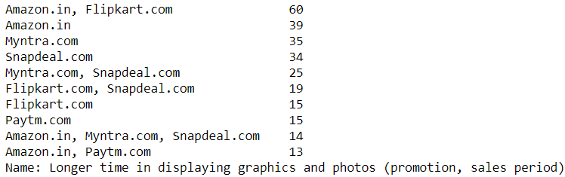
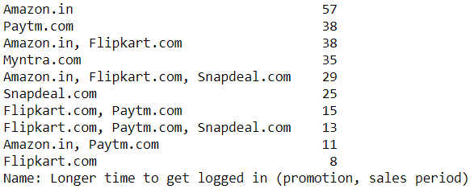
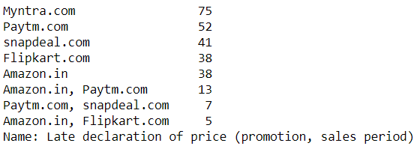
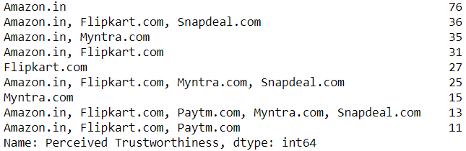
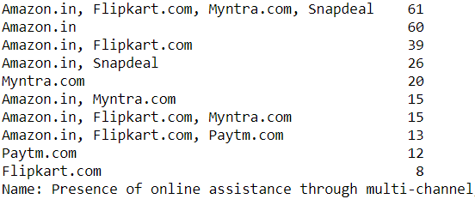

Slide 24
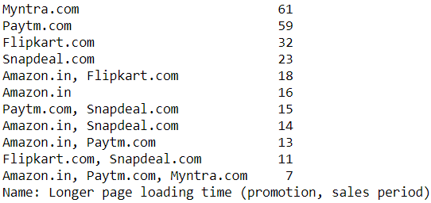
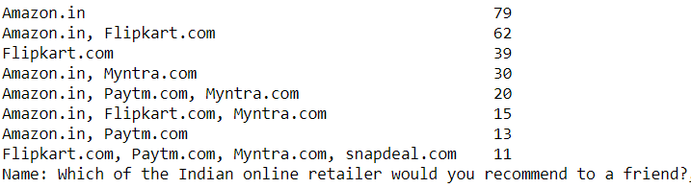





Slide 25

Favorite Retailers as per Questionaire

Slide 26
Conclusion of Descriptive Analysis
Comparing the Customer's Perceptions and the Company's performance we can conclude that the Companies likely to have
High Customer Satisfaction and Retention:
1. Amazon.com
2. Flipkart.com
High Risk of Customer Churn:
1. Myntra.com
2. Snapdeal.com

Slide 27
2. Inferential Statistics
First Hypothesis
H0: There is no association between gender and e-retail company (Gender and e-retail company are independent)
H1: There is an association between gender and e-retail company

Slide 28



Chi-squared Test
chi-square statistic:- 2.1852257166231297
critical_value: 14.067140449340169
Result: Failed to Reject H0, there is no association between gender and e-retail company recommended to a friend.

Slide 29
Second Hypothesis
H0: There is no association between age and e-retail company that person would recommend to a friend(age and e-retail company are independent)
H1: There is an association between age and e-retail company that person would recommend to a friend

Slide 30



Chi-squared Test
chi-square statistic:- 17.219333961318835
critical_value: 41.33713815142739
Result: Failed to Reject H0, Therefore, There is no association between age and e-retail company that person would recommend to a friend

